Slide 1
Resources for Federal Section 508 Program Managers

Slide 2



GSA
WHAT WE DO
Section 508 Transition Activities are underway and will centralize guidance, avoid duplication and streamline the transition to the revised standards.
Procurement
Technical Assistance
Training
Automated Tools
Accessibility Requirements Tool (ART)- Release 1
Solicitation Review Tool (SRT) Prototype
Policy and Best Practices
Requesting Accessibility Information
Revised 508 Standards Applicability Checklist
How to Define Accessibility Provisions Clauses
Agency Roadmap
Pulse Accessibility Module
Online Training Courses:
Section 508 Micro-Purchase
Section 508 Basics
IT Accessibility Playbook
Procuring Accessible ICT Products and Services
Section 508 Overview for Executives

Slide 3
GSA
508 TRANSITION GUIDE TABLE FOR AGENCIES
508 Program Activity | What’s changing | Where to get Guidance | What tools are available to help | What training is available | 508 Program Measure
Specify the Government’s Accessibility Requirements for new ICT projects (procured or built internally) | Section 508 requirements have been updated and now reflect WCAG 2.0 standards | Revised 508 Standards Applicability Checklist | -Accessibility Requirements Tool (ART) -Accessibility Conformance Reports/VPAT | -Section 508 Basics -Procuring Section 508 Conformant ICT Products and Services | # solicitations with accessibility requirements
Ensure solicitations (RFPs, RFQs,) contain appropriate contract language | Contract requirements have been clarified | -Best Practices: How to Request Accessibility Requirements from Vendors and Contractors -Best Practices: How to define Accessibility Terms and Conditions | -Solicitation Review Tool (SRT) - | -Procuring Section 508 Conformant ICT Products and Services -Section 508 for Purchase Card Holders (Micro Purchase) training | # solicitation corrected to include accessibility requirements
Manage Accessibility in the Agency’s life cycle | Agency Accessibility Policy need updating to reflect new requirements | Best Practices: Agency Accessibility Policy |  | -Section508 for Executives -Playbook training | -maturity of Agency accessibility policy

Slide 4
GSA
508 TRANSITION GUIDE TABLE FOR AGENCIES
508 Program Activity | What’s changing | Where to get Guidance | What tools are available to help | What training is available | 508 Program Measure
Ensure Accessible Electronic Content (Documents) | Requirement now includes official internal agency correspondence | AECOP – documents (list here) | -Accessibility Auditing Tools ($) | AECOP – Training Videos | # accessible documents – internal/external to agency
Test ICT products and software development projects for accessibility | Trusted Testing Protocol updated to reflect new standard | TTP on Section 508.gov | Trusted Testing Methodology | Trusted Testing Training Courses | # products tested # certified trusted testers
Ensure websites are accessible | Section 508 requirements have been updated and now reflect WCAG 2.0 standards | Section508.gov | -Pulse Accessibility Module (.gov only) -Commercial testing tools ($) -Commercial Overlay tools for presentation layer accessibility | WCAG Training | # accessible websites # improved websites
Know the Agency Need | Must now explicitly survey and identify number of employees with disabilities | -Technology Playbook |  |  | # disabled employees with AT deployed successfully
Complaint Process | No change? | -Technology Playbook ( | Best Practices Library |  | # complaints handled -maturity of complaint process

Slide 5
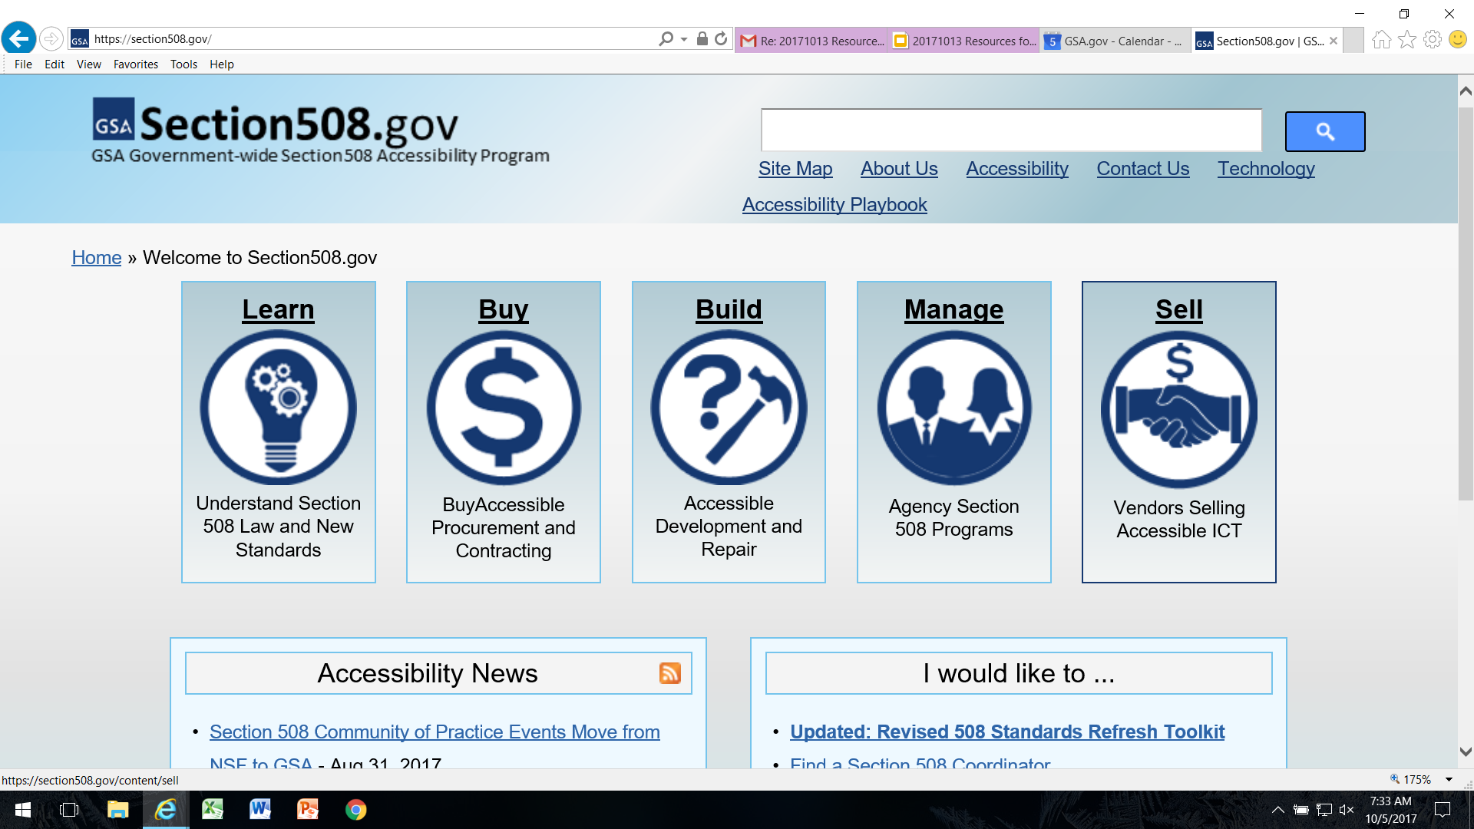
Section508.gov

Slide 6

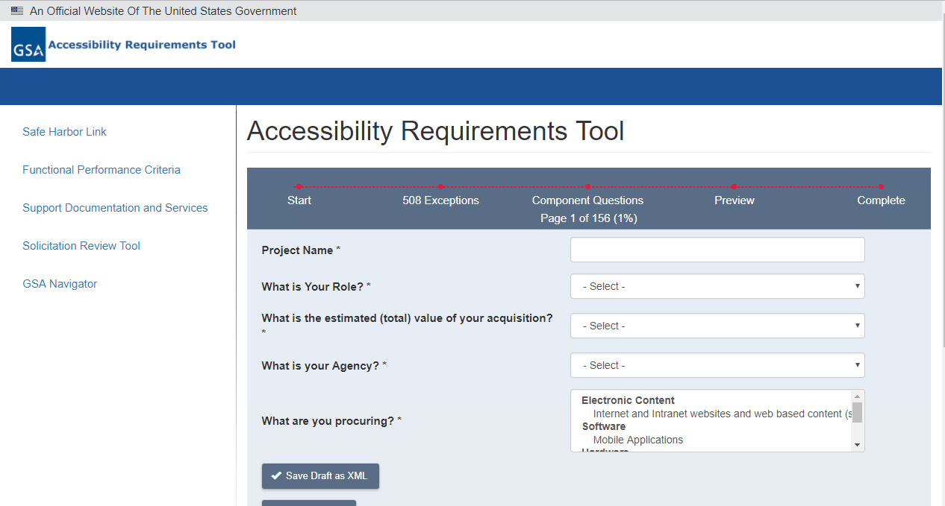
IT Accessibility
.GOV DOMAIN SERVICES - DOTGOV REGISTRAR
Accessibility Requirements Tool (ART)
DCOI Marketplace
Automates the process of generating accessibility requirements for procurements

Slide 7
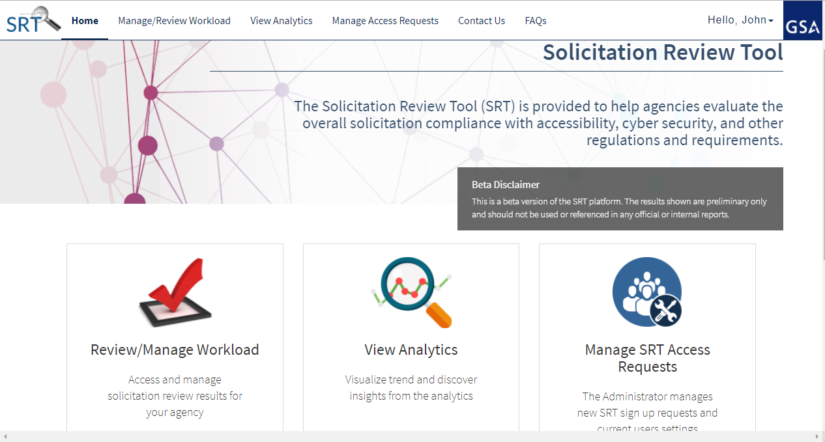
IT Accessibility
.GOV DOMAIN SERVICES - DOTGOV REGISTRAR
Solicitation Review Tool (SRT)
Uses A.I. to predict if FedBiz Op’s solicitations contain appropriate fed policy requirements (508 first)

Slide 8
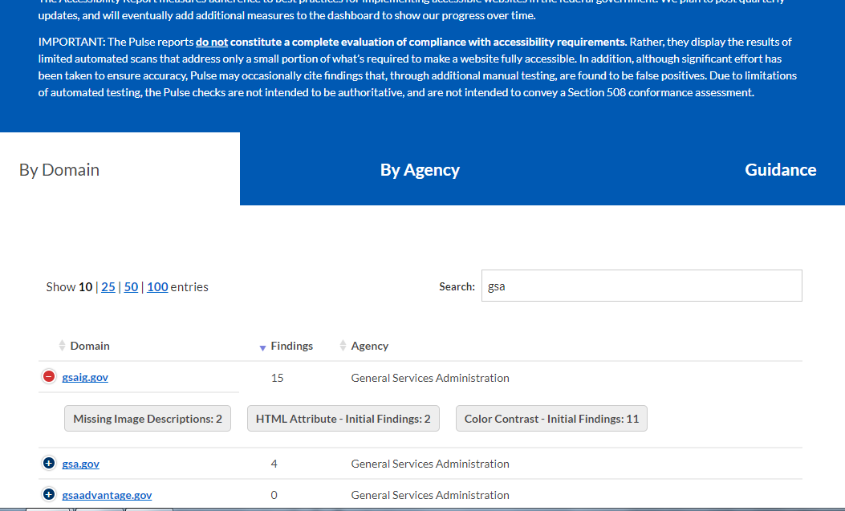
IT Accessibility
.GOV DOMAIN SERVICES - DOTGOV REGISTRAR
Pulse Accessibility Module
DCOI Marketplace
Pulse scans existing websites for policy compliance
Notes:
Mention accessibility

Slide 9
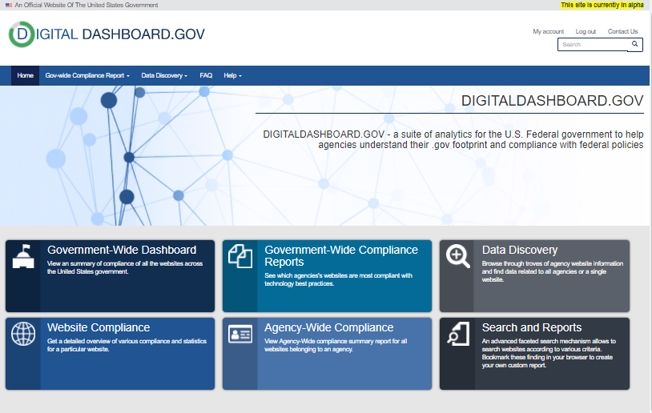
.Gov Domain Services
.GOV DOMAIN SERVICES - DOTGOV REGISTRAR
Digital Dashboard
DCOI Marketplace
Digital Dashboard will be the central “Feds Only”portal for CIOs to benchmark their websites against other agencies and industry standards.

Slide 10
Section 508 Training Courses
Located on the Federal Acquisition Institute:
Micro Purchase Course (FAC 047), published 10/4
Section 508: What is It and Why is It Important to You? (FAC 049), 10/31
IT Accessibility Playbook, to be developed in FY 2018
Procuring Section 508 Conformant ICT Products and Services, 12/31
To be located on www.section508.gov :
All of the above including:
Section 508 Overview for Executives, 12/31

Slide 11
QUESTIONS??

Slide 12
Contact Information Section.508@gsa.gov

